Slide 1


FREE
Smoke Alarm Program

Slide 2


Our goal:
All Kansans protected by working smoke alarms in their homes

Slide 3
How?
OSFM supports fire departments and volunteers across the state to install long-life sealed lithium battery powered smoke/carbon monoxide alarms free of charge
Provide free alarms for the hearing impaired directly to those who need them (application available on our website: FireMarshal.ks.gov/GetAlarmed)

Slide 4

Where should they be installed?

Slide 5
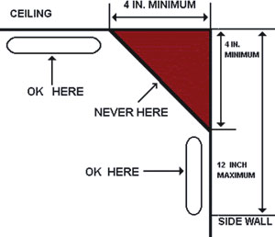
Where should they be installed?

Slide 6
Eligibility for Free Smoke/CO Alarms
Any home owner is eligible to receive an alarm at no cost.
The recipient will need to provide the installer with an address and telephone of their home. The installer will then make arrangements to get the alarm installed.
We are not able to replace an alarm for one that is already in working order.

Slide 7
Eligibility for Smoke/CO Alarms
Renters are ineligible for free smoke alarms. Landlords are legally required to provide them (KSA 31-162).
An exception to the above restriction is made for deaf and hard-of-hearing residents requesting special alarms designed for their needs.

Slide 8
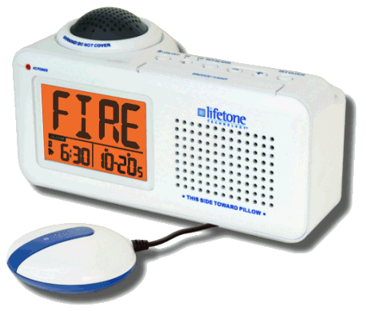
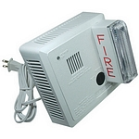
Alarms for Hearing Impaired
For our deaf or hard-of-hearing citizens, we now offer free alarm devices which alert the resident with loud sounds, flashing lights and by vibrating the person’s bed.
Application available at FireMarshal.ks.gov/GetAlarmed
Responds to the audible alert from a smoke alarm

Slide 9

REMINDER!
Test your smoke alarm monthly

Slide 10
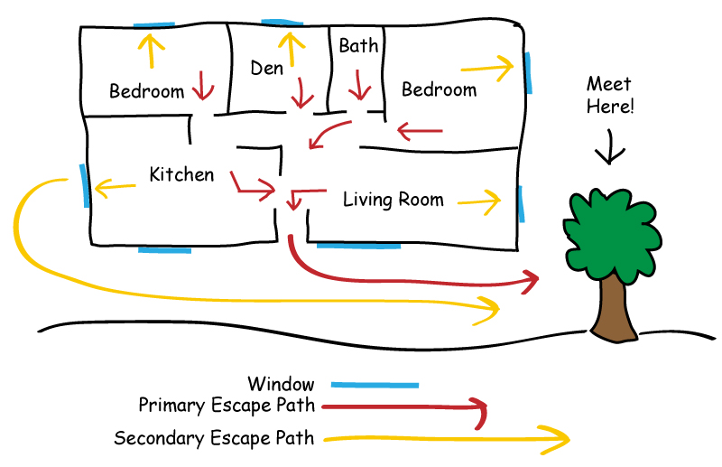
REMINDER!
Create and practice a home fire escape plan
(2 ways out of every room!)

Slide 11


Celebrating
2 Years
2,121
Smoke Alarms
Distributed FREE

Slide 12


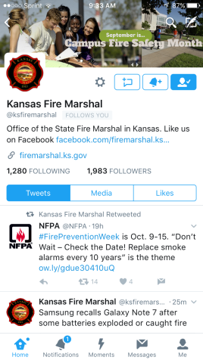
Get your phone out now and follow us on
@ksfiremarshal

