Slide 1
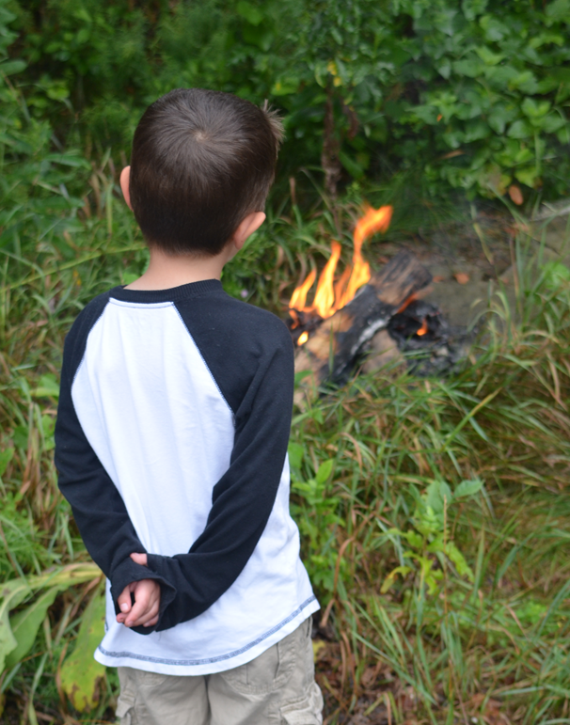
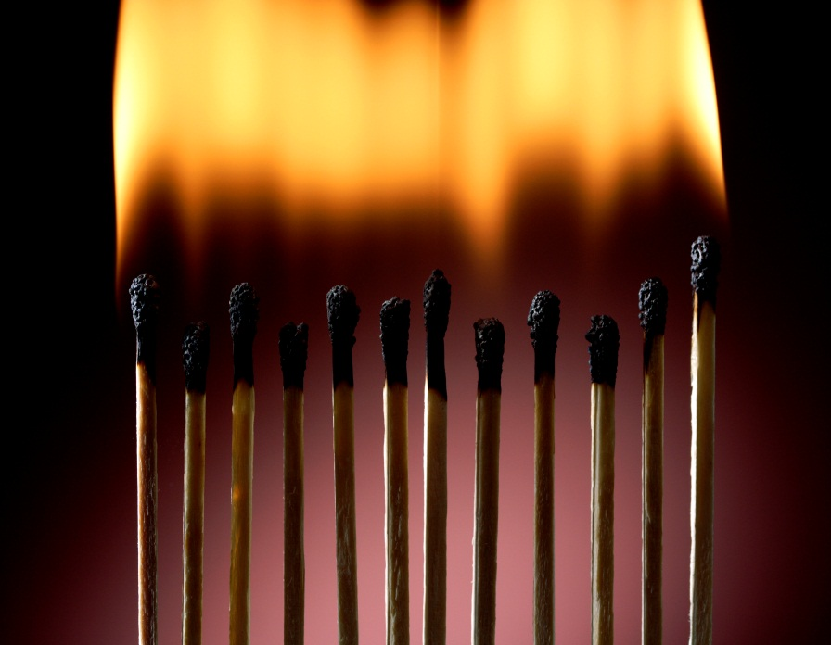
Youth Firesetting Prevention and Intervention (YFPI)
Notes:
This PowerPoint is designed to assist in building Youth Firesetting Prevention and Intervention Teams and enrolling stakeholders in the possibility of the program and inspire them to get involved.
The slides and links emphasize existing conditions and the importance of the programs.
Words that are underlined have internet links to videos expanding on the concepts.
Please use and edit this tool as you see fit.

Slide 2
Fire Statistics
ARSON #4 cause
Most Arson Arrests are kids under 17 years old.
Without Intervention, 85 % of youth firesetting behavior will continue
Most children who die in fire set that fire themselves
Notes:
Talking points:
Arson statistic from Fire In Minnesota 2011
Arrest information from MN Bureau of Criminal Apprehension in 2011 report
USFA is quoted on the last 2 points
Serial Arsonist Richard Aguilar started his first fire at age 11, he stated that it was accidental, he threw the cigarette he was smoking down in the garage when he heard his grandfather’s car pull up. He went inside to wash up then the garage was on fire. The investigators found what had happened, handcuffed him and drove him around to block to scare him, then released him into his grandmother’s care. He continued to set 50 more fires, intentionally before he was caught again. He has been out of the California jail system since 2002 and is still fascinated and would love to set more fires, but does not want to spend life in prison, which would be next.
He stated in a telephone conversation that educational intervention, attention and mental health referral after his first fire would have prevented his firesetting behavior.

Slide 3
Key Points About the Brain
Brain Development happens primarily through experience
The brain is only 17% wired at birth.
Children’s brains are not comp0letely wired until their mid-20’s
The brain has two major growth spurts
First 3 years of life
Adolescence
Windows of sensitivity – stimulus and experience have greater effect on the wiring of the brain
~ Megan E.B. Kelly, MSW ~ Allen Co. Juvenile Firesetters Task Force
Notes:
This is important because children cannot distinguish if what they see is real or not –
Consider the following slides.

Slide 4

Movies
Back Draft
Pirates of the Caribbean
Toy Story
Notes:
We see fire being misused every day:
Quote the listed movies and links or find your own examples

Slide 5

Commercials
Progressive
Taco Bell
Toyota
Budweiser
Notes:
More examples of the ways we see fire misused.
Can children’s brain comprehend this?

Slide 6

You Tube
Hair on fire
Bombs
Super Soakers
Kids playing?
Notes:
Copy cat behavior

Slide 7
Why do we need a program?
MEDIA
Children 8-18 spend 7:38 minutes a day consuming media.
29% of the time using more than one media at a time (laptop w/ TV) = 10:45 minutes per day
7:38 x 7 = 53 hours 25 min
X356 days = 2,786 hours 9 min
ADVERTIZING DRIVES
MEDIA
Television
Music
Computer
Movies
Video Games
Print
Kaiser Family Foundation, Generation M2: Media in the lives of 8-18 years, Jan 2010

Slide 8
“If you believe that Sesame Street taught your 4-year-old something, you better believe that MTV is teaching your fourteen-year-old something.”
~ Dr. David Walsh
Notes:
It is developmentally normal for children to mimic what they see
Creative paly has often been based on storied children have heard
“Whoever tells the story defines the culture” Dr. David Walsh
When television tells the story we get what advertisers pay for
~Megan E.B. Kelly

Slide 9
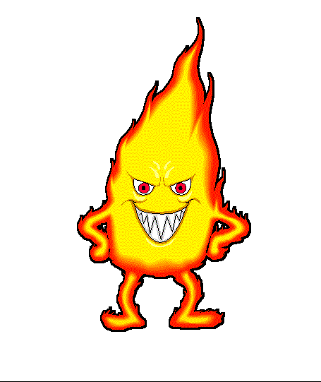
Urgency?
Fire burns differently now than it did even 15 years ago:
Notes:
Click on the underlined words for a you tube video of fire comparison by UL
The modern materials in the room burns much faster and stronger that in the legacy room of the 1980-90s. Cotton and wool burn much more slowly than do synthetics and petroleum based products.
This visual drives home the importance of identifying kids at risk.

Slide 10
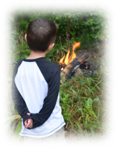
Referrals From:
Children at Risk
Juvenile Justice
Courts
Schools
Parent
Law Enforcement
Fire Departments
Families
Notes:
The link should encourage referrals from parents at the first sign of interest in fire.

Slide 11
The 1-800-500-8897 Process
1-800-500-8897
State Fire Marshal Division
Monitors phone & refers to:
Troubled / Pathological
Delinquent / Thrill Seeking
Curious
Crisis
Counseling / Residential Treatment
The Family’s Local Intervention Team *
who conducts the assessment using the standardized assessment tool determines if the child is:
Education
Education
Education
Counseling
Restorative Justice
Education under mental health’s supervision
*The local intervention team may consist of Fire Department, Social Services, Approved Citizen Helpers and / or Police Department personnel

Slide 12
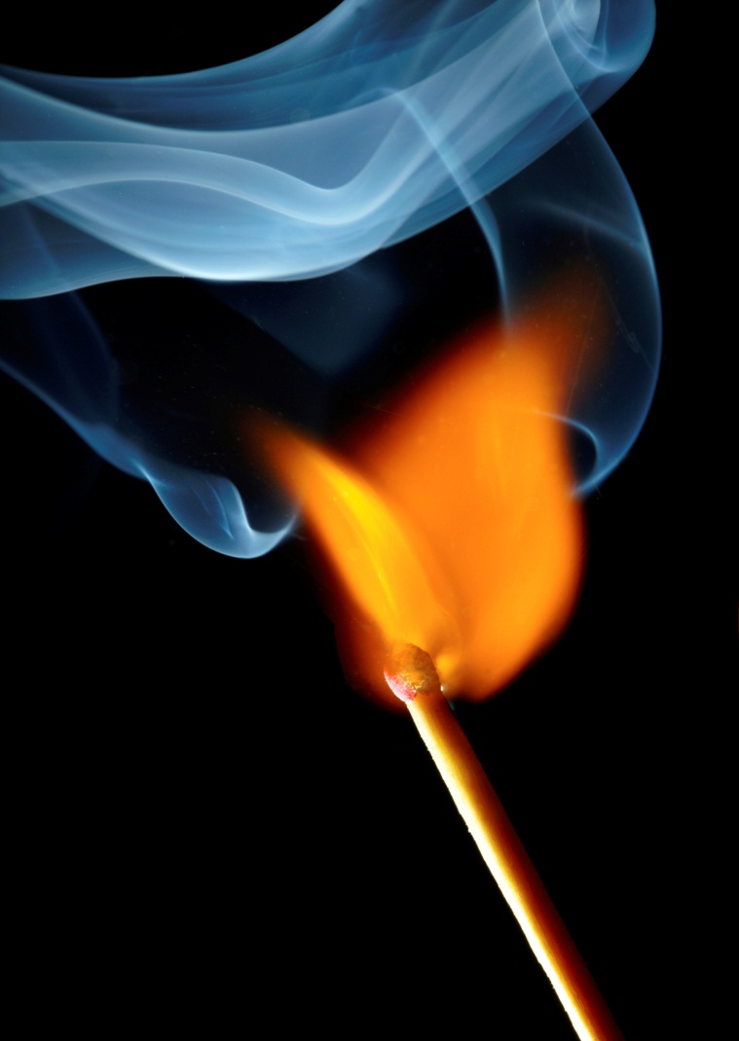
The FEMA Assessment Form
Reason for setting fire
Curiosity
Crisis
Delinquent / Thrill Seeking
Troubled / Pathological
Child & Family Risk Level
Low
Moderate
Extreme

Slide 13
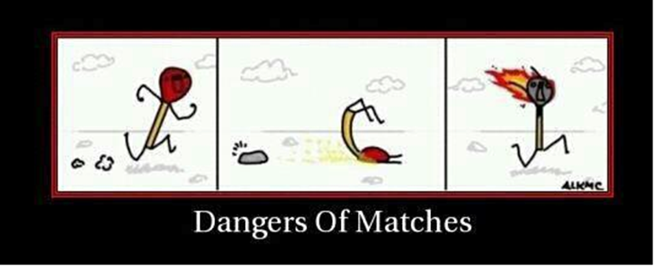
Notes:
Some children may tell you that this is how it happened.

Slide 14

Referrals to:
Mental Health
Residential Treatment Facilities
Social Services
Juvenile Justice
Restorative Justice
Fire Education
Notes:
This alludes to the importance of building relationships.

Slide 15
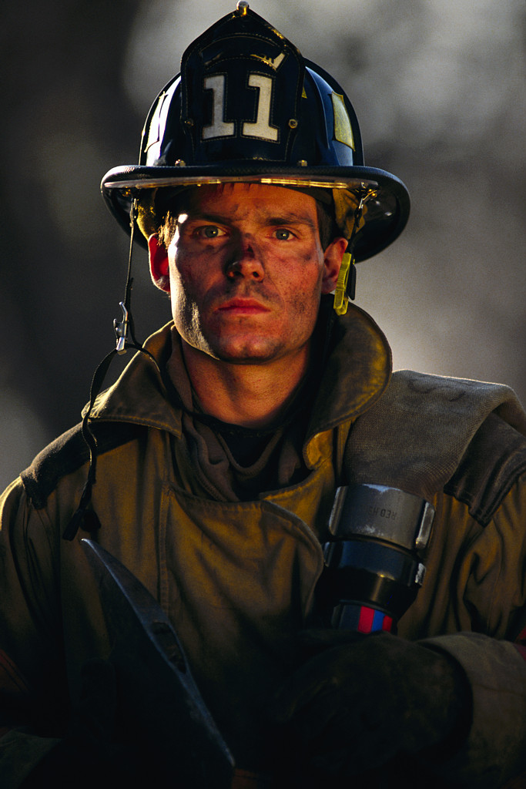
Educational Intervention
Rules & Laws
Fire Statistics
Fire Behavior
Fire Prevention
Burn Prevention
Fire Safety
Review & Test
Evaluations PLEASE!!

Slide 16
Justice?
To charge or not to charge?
Call
1-800-500-8897
Notes:
Some children really need residential treatment –
If they are charged the County pays 25%
Feds pay 75%
Only if they are charged.
If they go voluntarily it is up to the parents and / or their insurance.
Restorative Justice ideas.

Slide 17

Complete Diversion:
Goals:
Accuracy in Reporting
Provide Necessary Education
Provide Adequate Referrals
Consistency in Diversion
OTHERS?

Slide 18

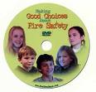
In Their Own Words
In their own words
And 4 Years Later
Notes:
The Minnesota State Fire Marshal Division has purchased master rights to these DVDs
If you are interested in obtaining a copy, please call 651-201-7220

Slide 19
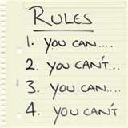




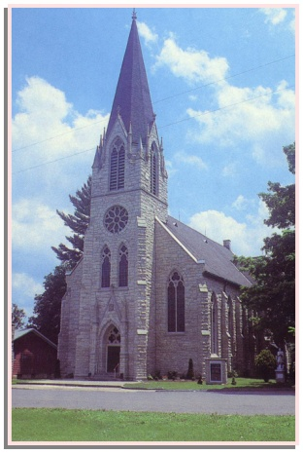
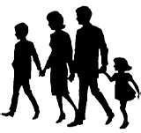
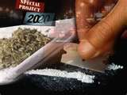
Road of Life
Notes:
The program is created to empower the children to make good choices.

